Slide 1

PRESENTED BY NAME USN SOWMYA D 4VM20CS051
Visvesvaraya Technological University
VIDYA VIKAS INSTITUTE OF ENGINEERING & TECHNOLOGY
VIDYA VIKAS INSTITUTE OF ENGINEERING & TECHNOLOGY,MYSORE
DEPARTMENT OF COMPUTER SCIENCE & ENGINEERING
PROJECT: MOVABLE CAMERA AND THE OBJECT
Under the guidance of
Dr. Madhusudhan G K
Assistant Professor
Dept. Of CSE , VVIET

Slide 2
CONTENTS
Department of Computer Science and Engineering
VIDYA VIKAS INSTITUTE OF ENGINEERING & TECHNOLOGY
Problem Statement
Introduction
Scope
System requirements
Implementation
Snapshots
Conclusion
Reference
2022-2023

Slide 3
Department of Information Science and Engineering
VIDYA VIKAS INSTITUTE OF ENGINEERING & TECHNOLOGY
PROBLEM STATEMENT
In our project we are going to demonstrate the moving of a “MOVABLE CAMERA
AND THE OBJECT” viewer can see a cameras moving. We have mainly used the concept of translation. We have developed this project using OpenGL. It is a software interface to graphic hardware. The OpenGL utility library (GLU) provides many of the modelling features. GLU isa standard part of every OpenGL Implementation.

Slide 4
Department of Computer Science and Engineering
VIDYA VIKAS INSTITUTE OF ENGINEERING & TECHNOLOGY
INTRODUCTION
The development of any project will improve the user’s knowledge. MOVABLECAMERA AND OBJECT is a interactive simulation created using Microsoft VisualBasic and OpenGL programming toolkit. This package shows simple applications of computergraphics in consecutive transformations applied to altered coordinate systems.
The Computer Graphics is one of the most powerful and interesting face of computers.The aim of this project is to learn about the concepts in Graphics and know standard library “Graphics Function” and also to explore some other functions.
This program enables the user to move camera and object along the X/Y/Z axis. Here wehave both keyboard and mouse interaction. When a key is pressed and mouse button is pressedthecorresponding actiontakes place.

Slide 5
Department of Computer Science and Engineering
VIDYA VIKAS INSTITUTE OF ENGINEERING & TECHNOLOGY
SCOPE
In a computer graphics (CG) mini project, the term "flag hoisting" could refer to a simulation or animation of a flag being raised on a flagpole using computer-generated graphics. The scope and application of such a project can vary depending on the specific goals and requirements. Here are a few possible scopes and applications of a flag hoisting project in the context of computer graphics:
Educational Purposes: A flag hoisting project can be developed as a learning tool to help students understand and visualize the principles of computer graphics. It can serve as an interactive demonstration of concepts such as animation, keyframing, transformation, and rendering technique.
2. Virtual Environments: Flag hoisting can be utilized in virtual reality (VR) or augmented reality (AR) applications to create immersive experiences. For example, in a historical or military-themed simulation, a flag hoisting animation can enhance the realism and sense of presence in the virtual environment.

Slide 6
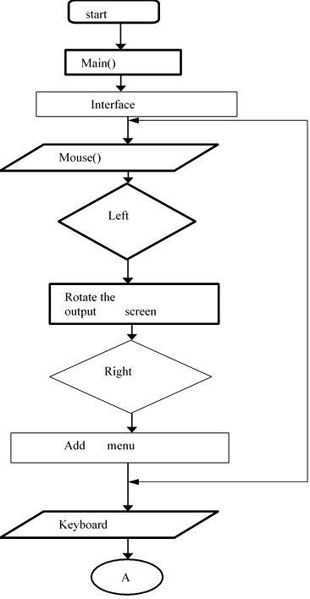
Department of Computer Science and Engineering
VIDYA VIKAS INSTITUTE OF ENGINEERING & TECHNOLOGY
FLOW CHART
2022-2023

Slide 7
Department of Computer Science and Engineering
VIDYA VIKAS INSTITUTE OF ENGINEERING & TECHNOLOGY
SYSTEM REQUIREMENTS
HARDWARE REQUIREMENTS
Processor : Intel Processor 4.0GHz and above
RAM : 1GB DDR with 256 MHZ
Hard disk : 4 GB and above
SOFTWARE REQUIREMENTS
Operating System : Ubuntu 14.04
Language : Vi Editor
API : OpenGL Library Toolkit

Slide 8
Department of Computer Science and Engineering
VIDYA VIKAS INSTITUTE OF ENGINEERING & TECHNOLOGY
IMPLEMENTATION
Implementation is the carrying out, execution, or practice of a plan, a method, or any design for doing something. It encompasses all the processes involved in getting new software or hardware operating properly in its environment, including installation, configuration, running, testing, and making necessary changes. The word deployment is sometimes used to mean the same thing. This section will investigate the distinctive viewpoints concerned about the implementation of the developed system.
2022-2023

Slide 9
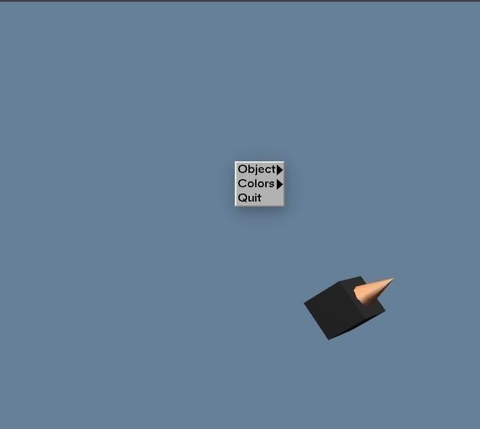
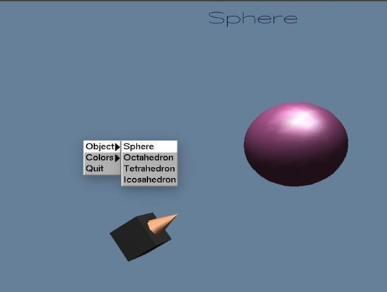
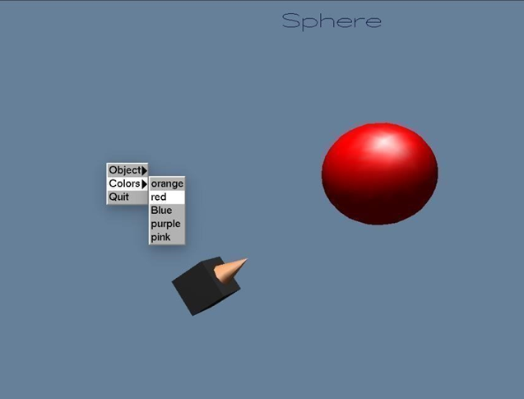
Department of Computer Science and Engineering
VIDYA VIKAS INSTITUTE OF ENGINEERING & TECHNOLOGY
SNAPSHOTS

Slide 10
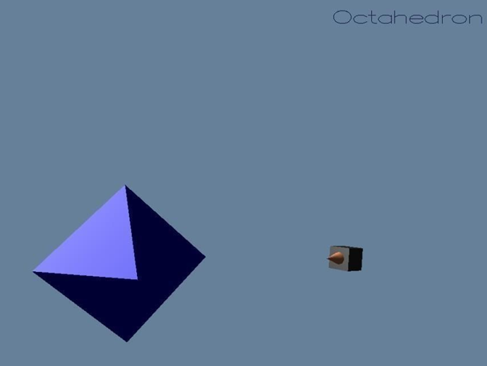
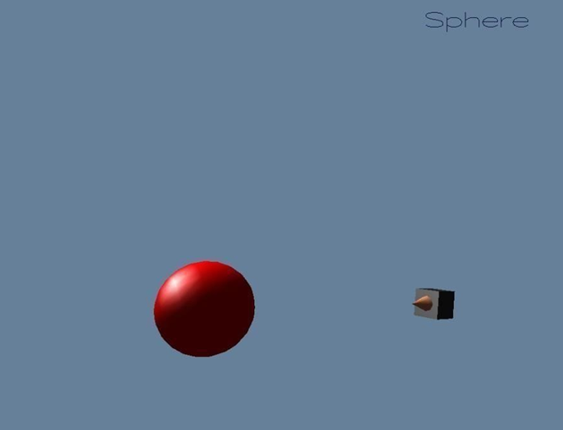
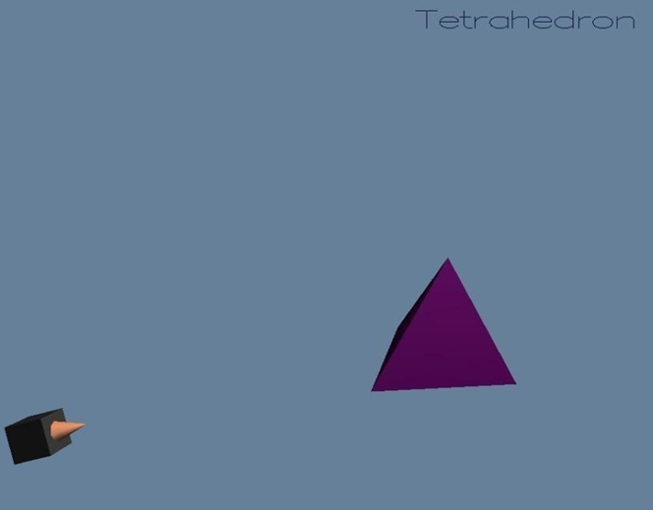
Department of Computer Science and Engineering
VIDYA VIKAS INSTITUTE OF ENGINEERING & TECHNOLOGY

Slide 11
Department of Computer Science and Engineering
VIDYA VIKAS INSTITUTE OF ENGINEERING & TECHNOLOGY
CONCLUSION
We have proposed in this paper a review of methods for moving objects detection with a moving camera categorized. the current image is registered to the background model in order to do the subtraction and obtain the moving objects. when several cameras are used, static and moving, it could be interesting to couple information to detect moving objects. when a moving object is detected in the static camera, generally with a large-view, the moving camera, generally a PTZ camera, will move to detect the moving object.

Slide 12
Department of Computer Science and Engineering
VIDYA VIKAS INSTITUTE OF ENGINEERING & TECHNOLOGY
REFERENCES
Donald Hearn & Pauline Baker: Computer Graphics with OpenGL Version,3rd
/ 4th Edition, Pearson Education,2011.
2. Edward Angel: Interactive Computer Graphics- A Top Down approach with OpenGL, 5th edition. Pearson Education, 2008 Google [online] available at https://www.opengl.org/resources/libraries/glut/spec3/node113.html accessed on [20-05-2019] .
3. Google [online] available athttps://www.artificialintelligenceinindia.com/water-jug-problem-artificial-intellige nce/amp/ accessed on [21-05-2019]
4. Snehal Solanki, Prem Parmar, Parth Shukla, Dhruvin Patel, Mr. Nimit Modi, Dr.
5. Sheshang Degadwala, “A Review on Two Water Jugs Problem via an Algorithmic
6. Approach” International Journal of Scientific Research in Science, Engineering and Technology| Online ISSN : 2394-4099, Volume 4, Issue 5 (March-April, 2017), PP. 331-334 .

Slide 13

Department of Computer Science and Engineering
VIDYA VIKAS INSTITUTE OF ENGINEERING & TECHNOLOGY
2022-2023

